Slide 1
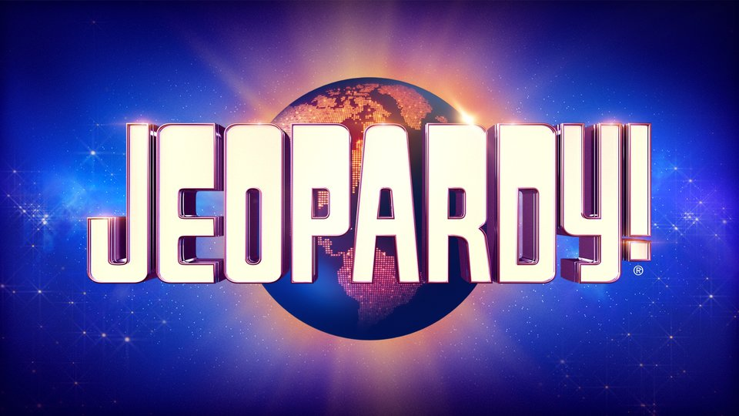
Classification of Jeopardy
Seth Singson-Robbins
MS of Data Science
Fordham University
NLP Final Project

Slide 2
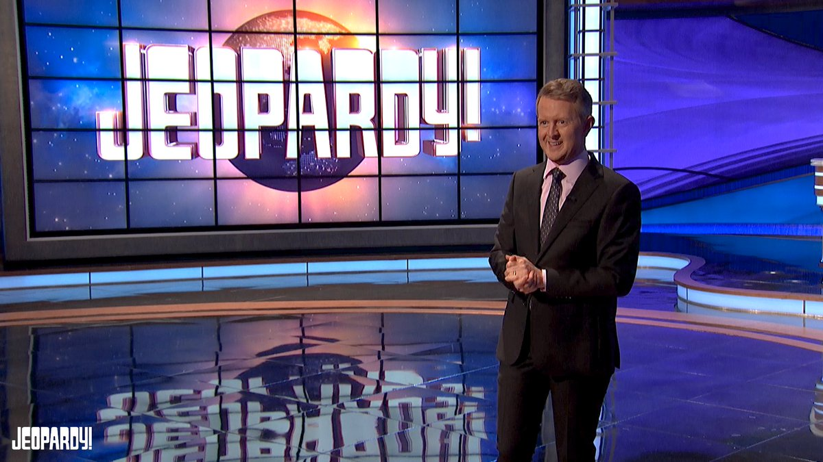
What we are going to cover
What is Jeopardy?
Data Exploration
Preprocessing and Modeling
Results Analysis
Conclusion

Slide 3
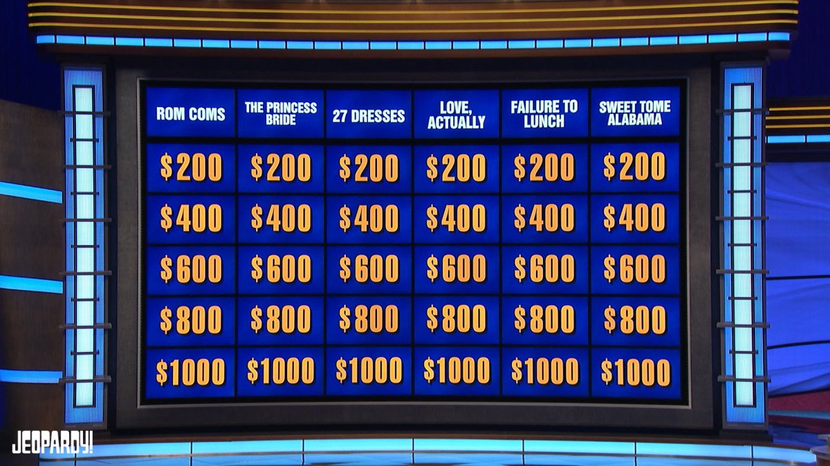
What is Jeopardy?
History of the Game
Started on 1964, weeknights on primetime TV since 1984
25 Countries have their own versions
34 Emmys
Gameplay
3 Rounds
Jeopardy! - 6 categories with 5 questions each
Double Jeopardy - same but values are doubled
Final Jeopardy - Own Wagers
Daily Doubles - wagers in middle of game, not known until tile picked
Tiles have the answer, you respond in the form of a question
For this analysis, ‘answers’ will be called the problem, ‘questions’ will be called the solution

Slide 4
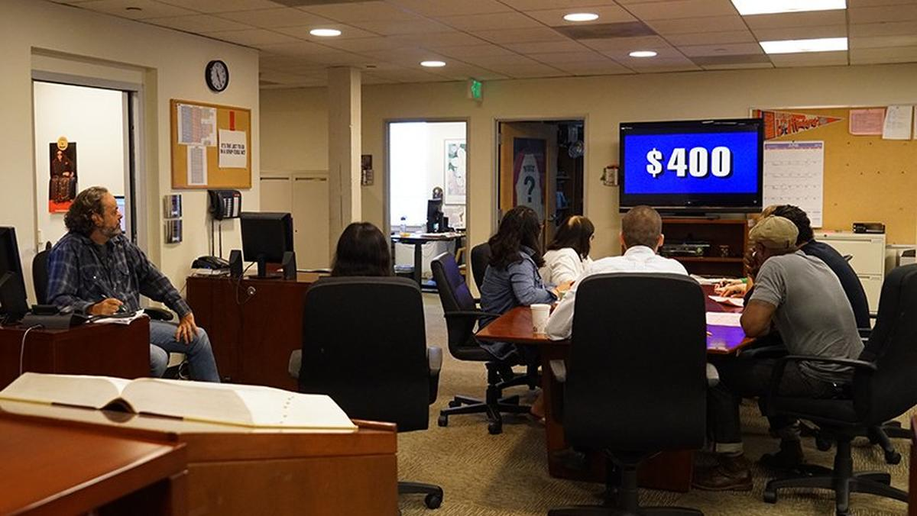
How are Jeopardy questions created?
14,030 Questions a Year
8 Writers and 7 Researchers
Writers
Write up the questions
Head writer picks which ones to use and orders them easiest to hardest
Researchers
Check if accurate
Notes:
Questions thrown out if all or none of the writers can answer a question, leads to a narrow range of difficulty

Slide 5
Data Exploration

Slide 6
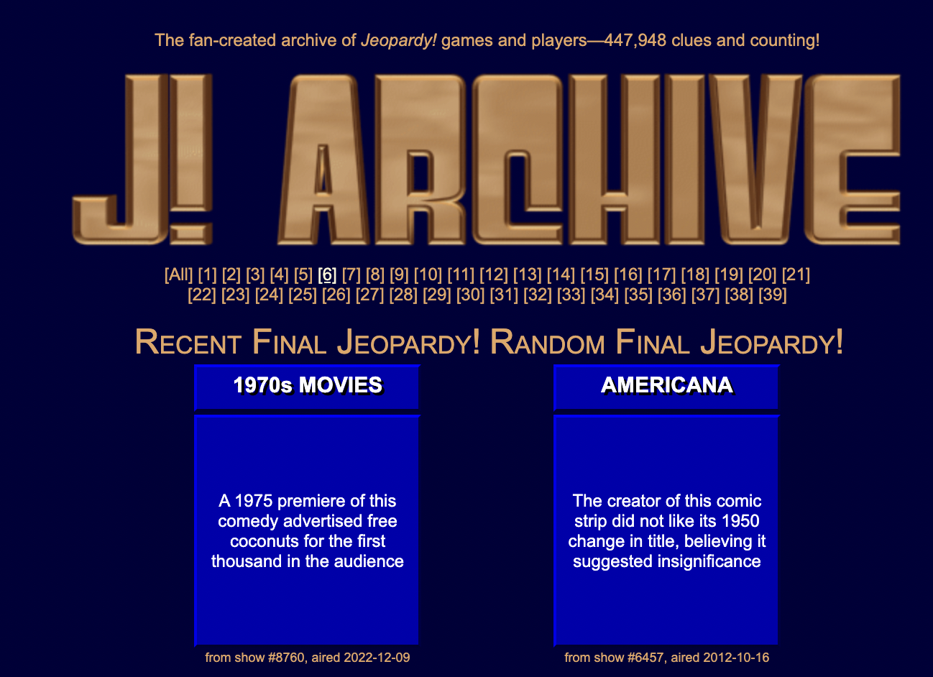
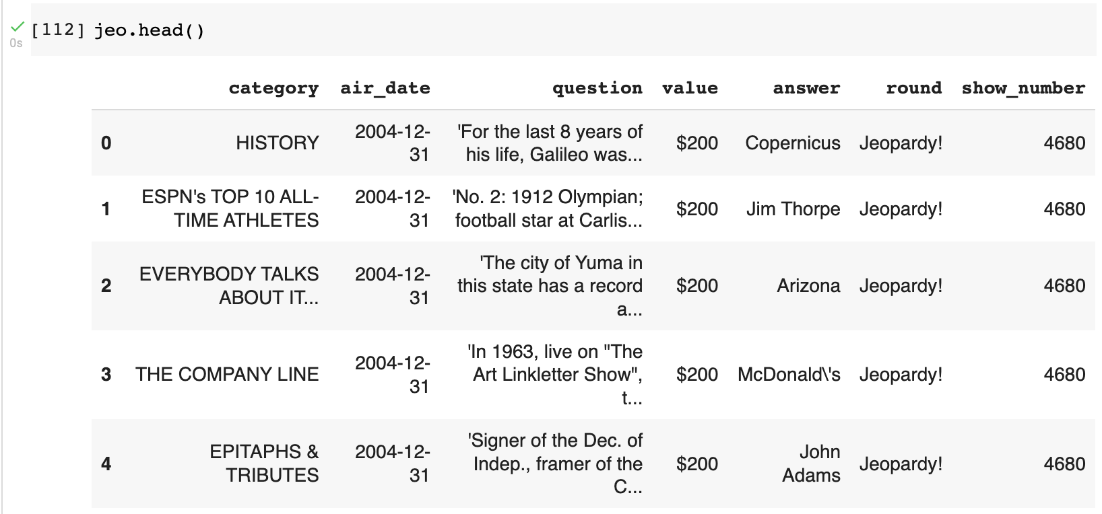
Jeopardy Dataset
Notes:
J-Archive - Question bank made by fans and old contestants
JSON file found on Kaggle

Slide 7
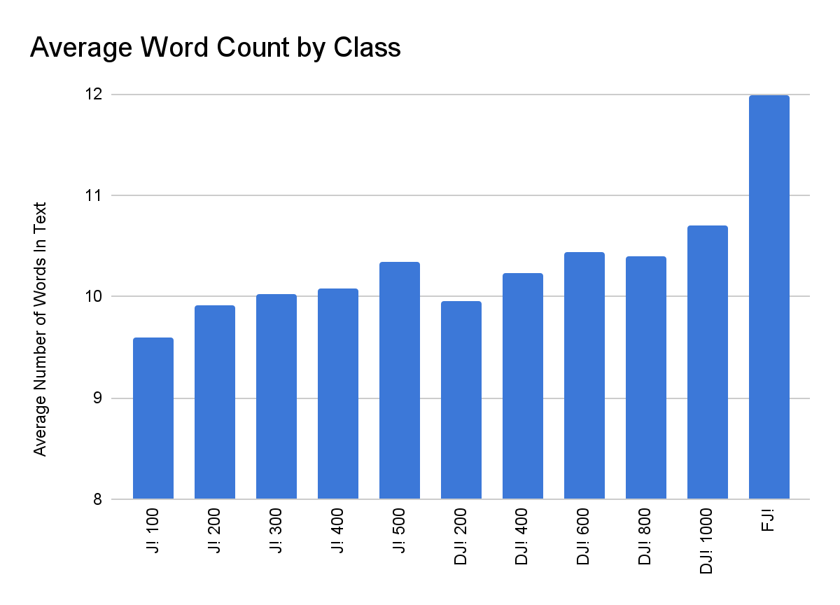
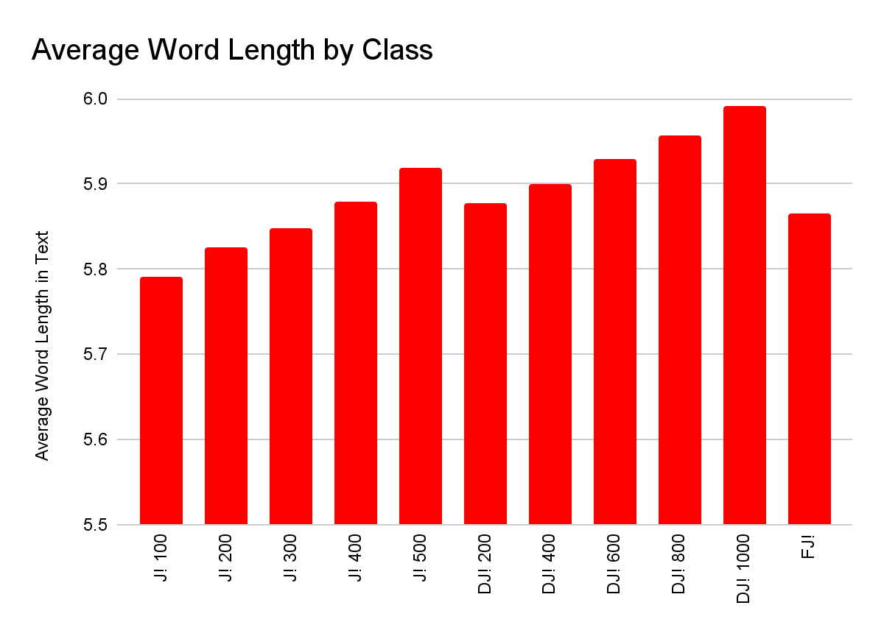
Word Based Information
Notes:
Average word count - increase by both value and round, large increase in Final Jeopardy
Average Word Length - Same except final jeopardy

Slide 8
Most Common Words
Top Words | J! 100 | J! 200 | J! 300 | J! 400 | J! 500 | DJ! 200 | DJ! 400 | DJ! 600 | DJ! 800 | DJ! 1000 | FJ!
1 | one | one | one | one | name | one | one | one | one | name | 2
2 | first | first | name | name | one | first | name | name | name | one | first
3 | name | name | first | first | first | name | first | first | first | first | name
4 | city | city | city | city | city | city | city | city | city | city | one
5 | 2 | 2 | new | 2 | 2 | country | country | clue | man | clue | u.s.
6 | state | new | seen | named | named | new | 2 | country | country | seen | man
7 | new | country | 2 | new | seen | 2 | man | man | named | named | named
8 | country | state | man | seen | country | man | new | 2 | 2 | called | 1
9 | u.s. | seen | state | man | state | state | seen | crew | film | crew | world
10 | man | man | like | state | new | called | named | film | new | new | city
Notes:
Italicized - 10+ categories
Bold - 2 or less categories

Slide 9
Preprocessing and Modeling

Slide 10
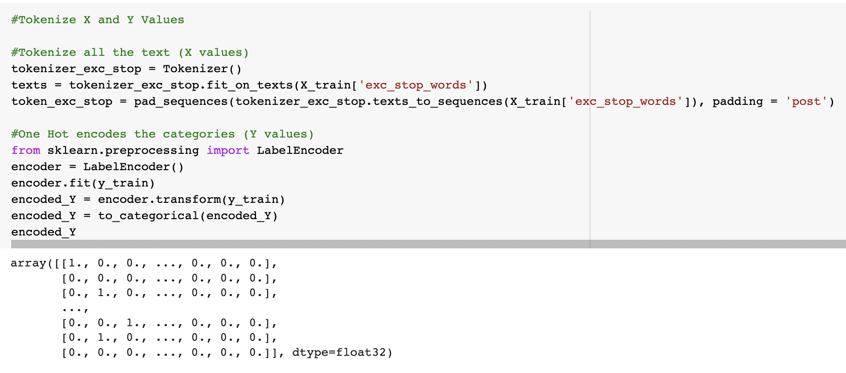
Preprocessing
Value processing
Value by year regulation
Dollar Signs
Category Array
Text Processing
Contractions
Stop Words
Picture/Video Links
Problem and Solution concatenation
Tokenization
Padding

Slide 11
Embeddings
TfIdf
Model that creates array based on how often word occurs based on other texts
Top 1000 most important words for modeling included
Glove
Count based model from Google
50 values per word
Word2Vec
Co-occurrence based embedding model by Stanford
100 values per word
BERT
Transformer Bidirectional Model
Small BERT
4 Layers
128 Values Per Text
Transforms the data into an array before putting into other models

Slide 12
Models
Including hyperparameters
Neural Networks
Simple Neural Network
Recurrent Neural Network
Convolutional Neural Network
Hyperparameters: Epochs, Hidden Layers, Dropout
Other Machine Learning Models
Logistic Regression
Hyperparameters: C, Solver, Penalty
Naive Bayes
Hyperparameters: fit prior, alpha

Slide 13
Validation Results by Model
Model | GloVe | Word2Vec | BERT | TdIdf
Typical NN | 14.2% | 13.9% | 13.7% | 13.0%
RNN | 15.5% | 14.8% | 13.0% | NA
CNN | 13.8% | 13.1% | 13.7% | 12.8%
LR | 11.4% | 12.0% | 12.2% | 12.4%
NB | 13.3% | 13.0% | 12.3% | 13.4%

Slide 14
Results Analysis

Slide 15
Category Performance Breakdown
Accuracy on the test data was 15.2%
47% higher than picking most common category
Best recall was Jeopardy! $100 and Double Jeopardy! $200.
Low precision across the board so a lot of incorrect categorizing across the board.
Category | Precision | Recall
Jeopardy! $100 | 16% | 44%
Jeopardy! $200 | 12% | 8%
Jeopardy! $300 | 12% | 8%
Jeopardy! $400 | 11% | 24%
Jeopardy! $500 | 14% | 11%
Double Jeopardy! $200 | 19% | 37%
Double Jeopardy! $400 | 14% | 25%
Double Jeopardy! $600 | 12% | 9%
Double Jeopardy! $800 | 11% | 4%
Double Jeopardy! $1000 | 13% | 1%
Final Jeopardy! | 24% | 13%

Slide 16
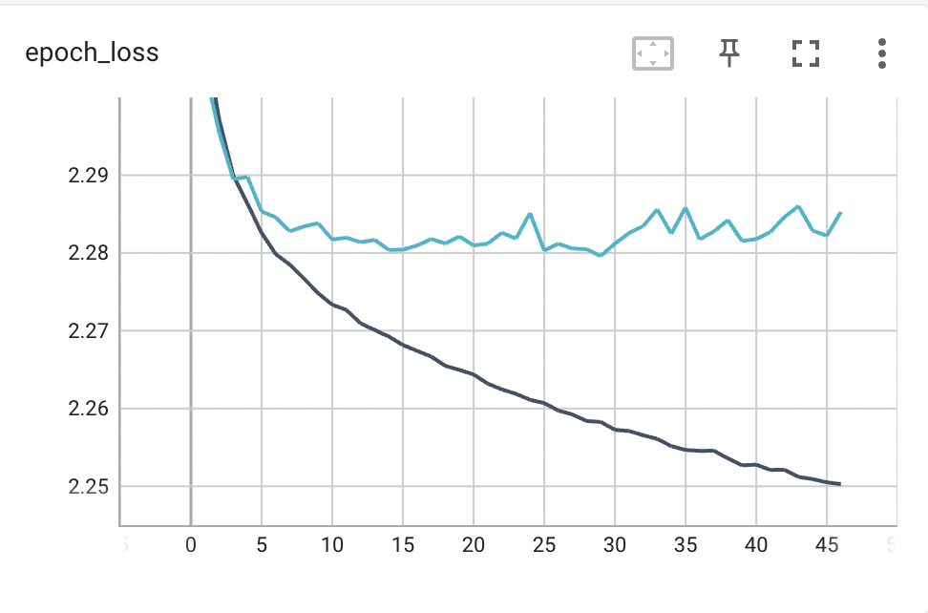
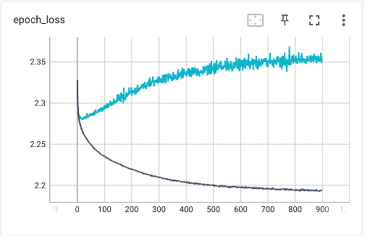
Epoch Loss - Overfitting

Slide 17
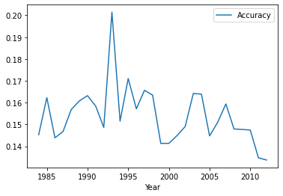
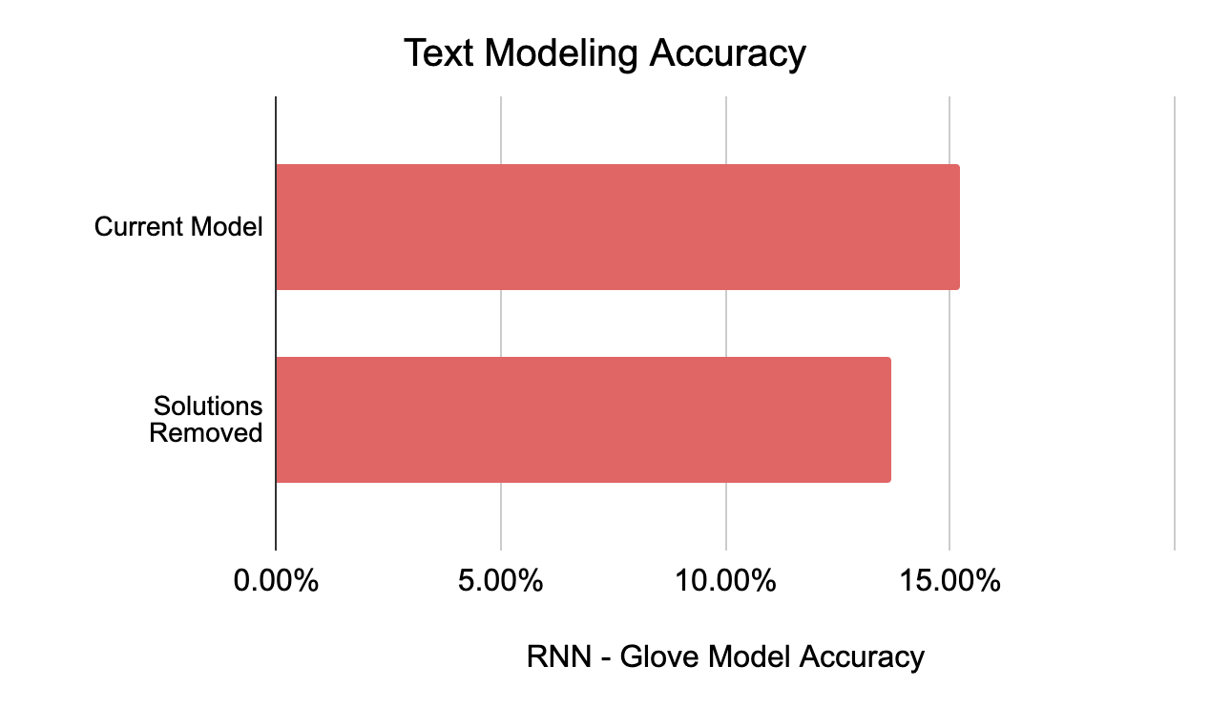
Accuracy By Year Solutions Removed
From Text

Slide 18
Conclusion
The accuracy was pretty low for this model but some patterns do emerge.
Accuracy of valuation by the head writer
Recommendations on next steps or other models:
User Research: Interview the writing team and head writer in how they actually determine what the value of a question is.
Other categorizations
Ordinal placement of these models
Round Only
Values only
Model by category: Cluster categories and have separate model for each category

Slide 19
Related Work
Rajarshi Ghoshal (Kaggle)
Did a prediction model with just what round they are in
Used random forests
Awisk (Medium)
Predict ordinal level within category (0 for $100, 4 for $500)
25% improvement at 25% accuracy (20% random guessing)
Michael Bartee (Github)
Similar to our study but with extra information like category topic
15.6% accuracy
Did high vs low values ($1200 cut off between levels)
67% accuracy, 15% recall

Slide 20
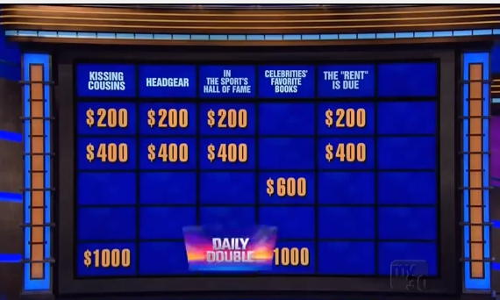
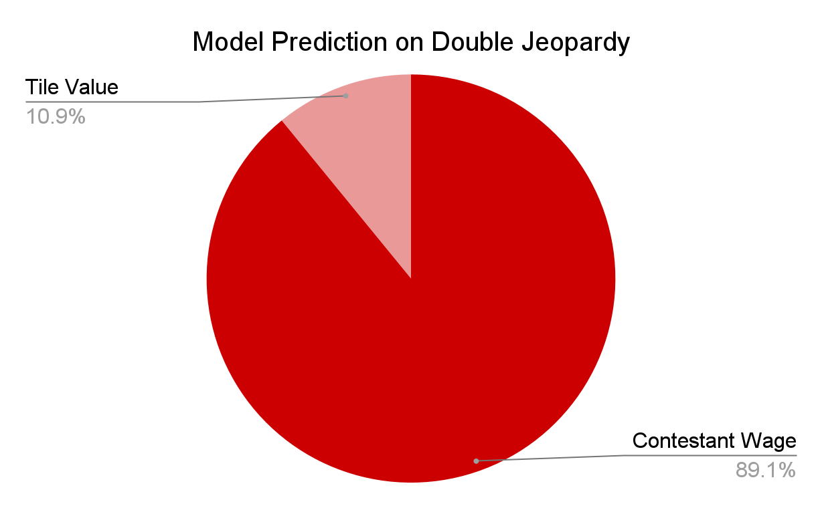
Daily Doubles
Notes:
Not super accurate

